Slide 1
Content Objective: Students will present their research on various ethical dilemmas and discuss future natural interactions with AI
Happy Friday June 21st
Recap Yesterday
Work on Data Reasoning Research / Present
Natural Interaction / Future Prospects
Homework
No homework in the course. But I will make you think!

Slide 2

Machine Learning Levels
Pick one to teach the class....
Narrow Intelligence
General Intelligence
Super Intelligence

Slide 3

Ethics of Machine Learning
The “Student - Master” Dilemma

Slide 4
Data Representation / Reasoning - Ethical Dilemmas
Choose a topic to research...
Just like before we will make little posters and you will “teach” these subjects to the class…(groups that did not go last time will go this time)
Uygur Muslim Humanitarian Crisis in China
Autonomous Weapons
China’s “Social Credit” System (Coming to America?)
Deep Fakes / New Age Propaganda

Slide 5

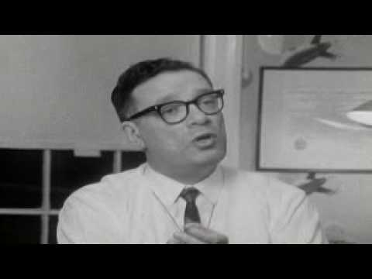


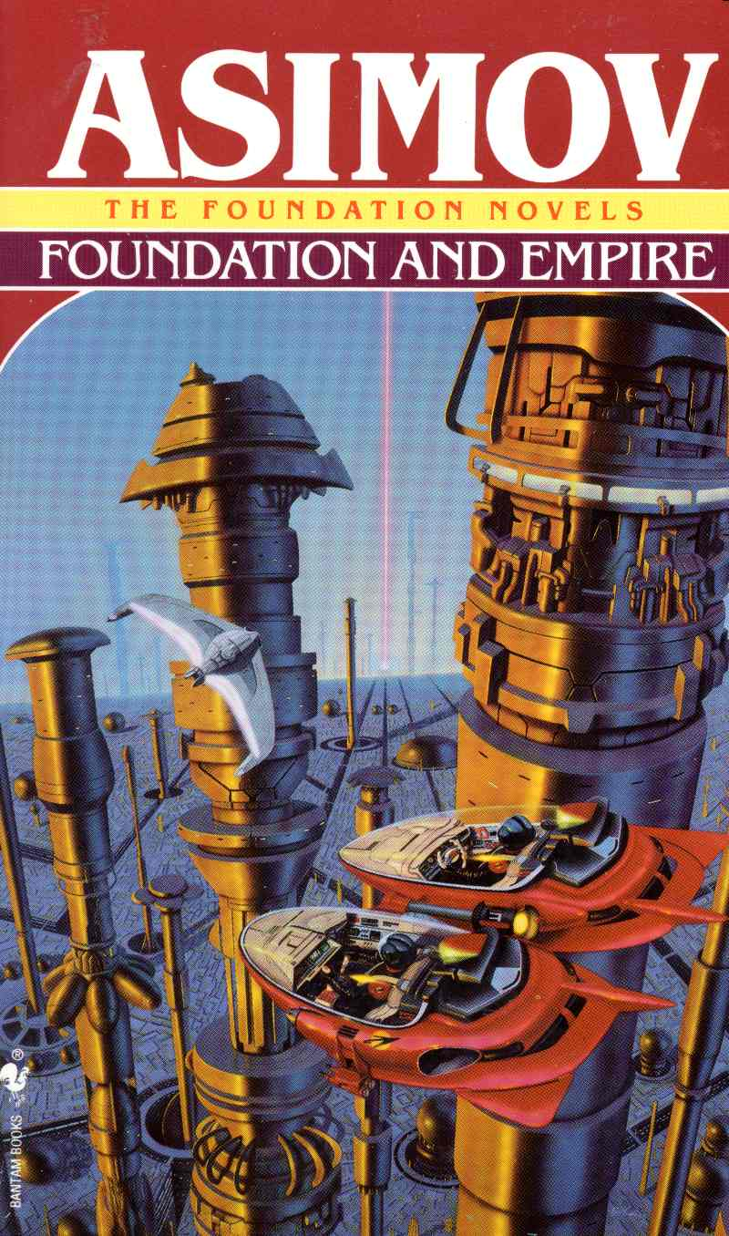
Natural Interactions With AI
(aka Robotics)

Slide 6
Isaac Asimov’s Three Laws of Robotics
A robot may not injure a human being or, through inaction, allow a human being to come to harm.
A robot must obey orders given it by human beings except where such orders would conflict with the First Law.
A robot must protect its own existence as long as such protection does not conflict with the First or Second Law.
What do you think of these “laws?”
Can you think of scenarios for a robot / human that may break or dismantle these laws?

Slide 7
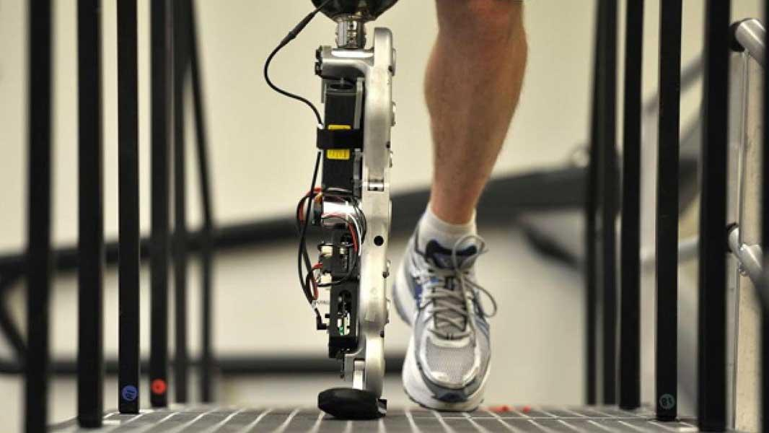
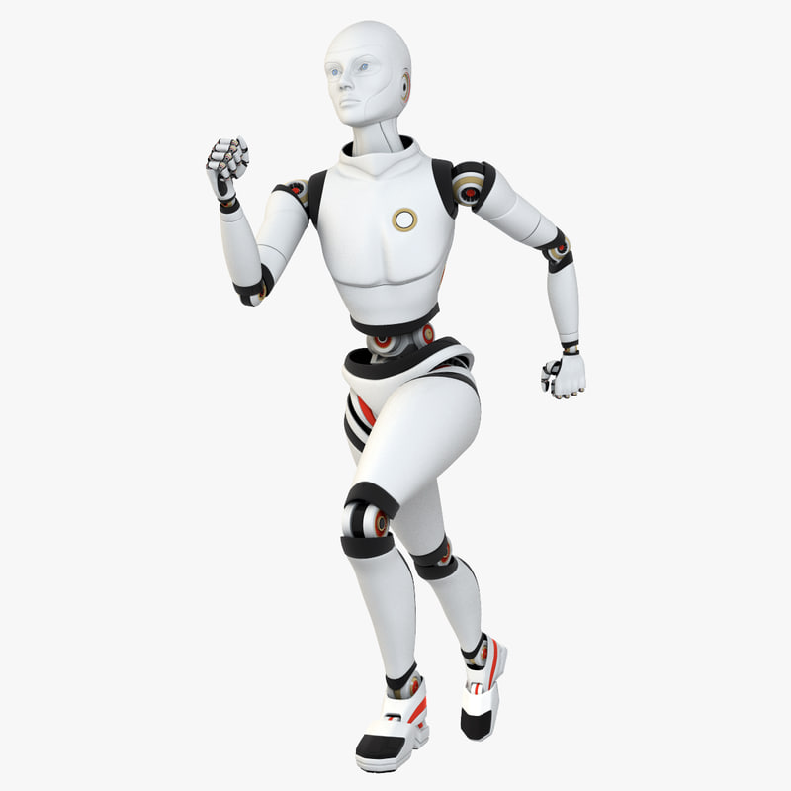
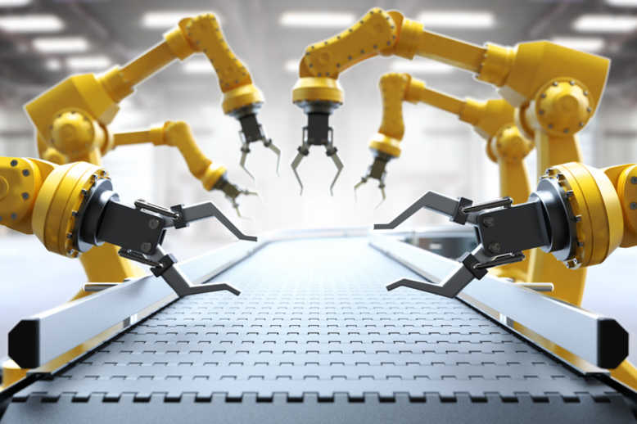
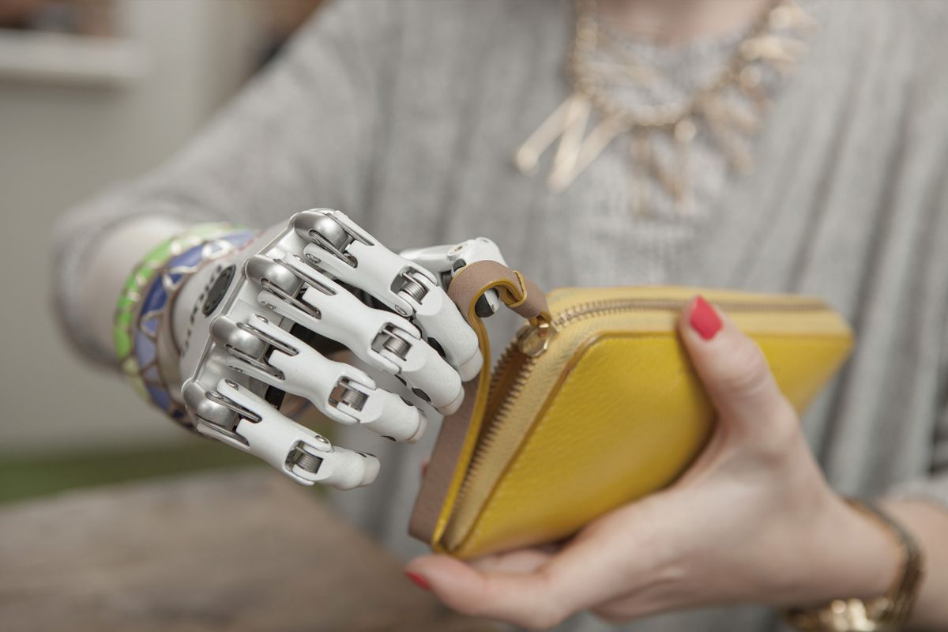
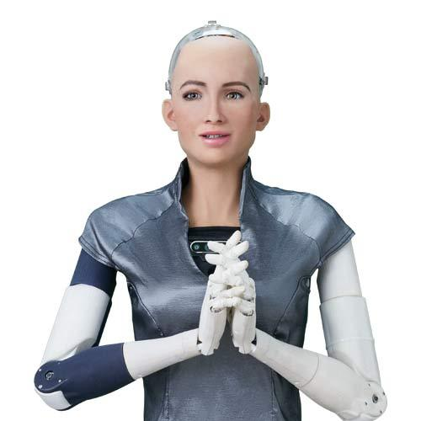
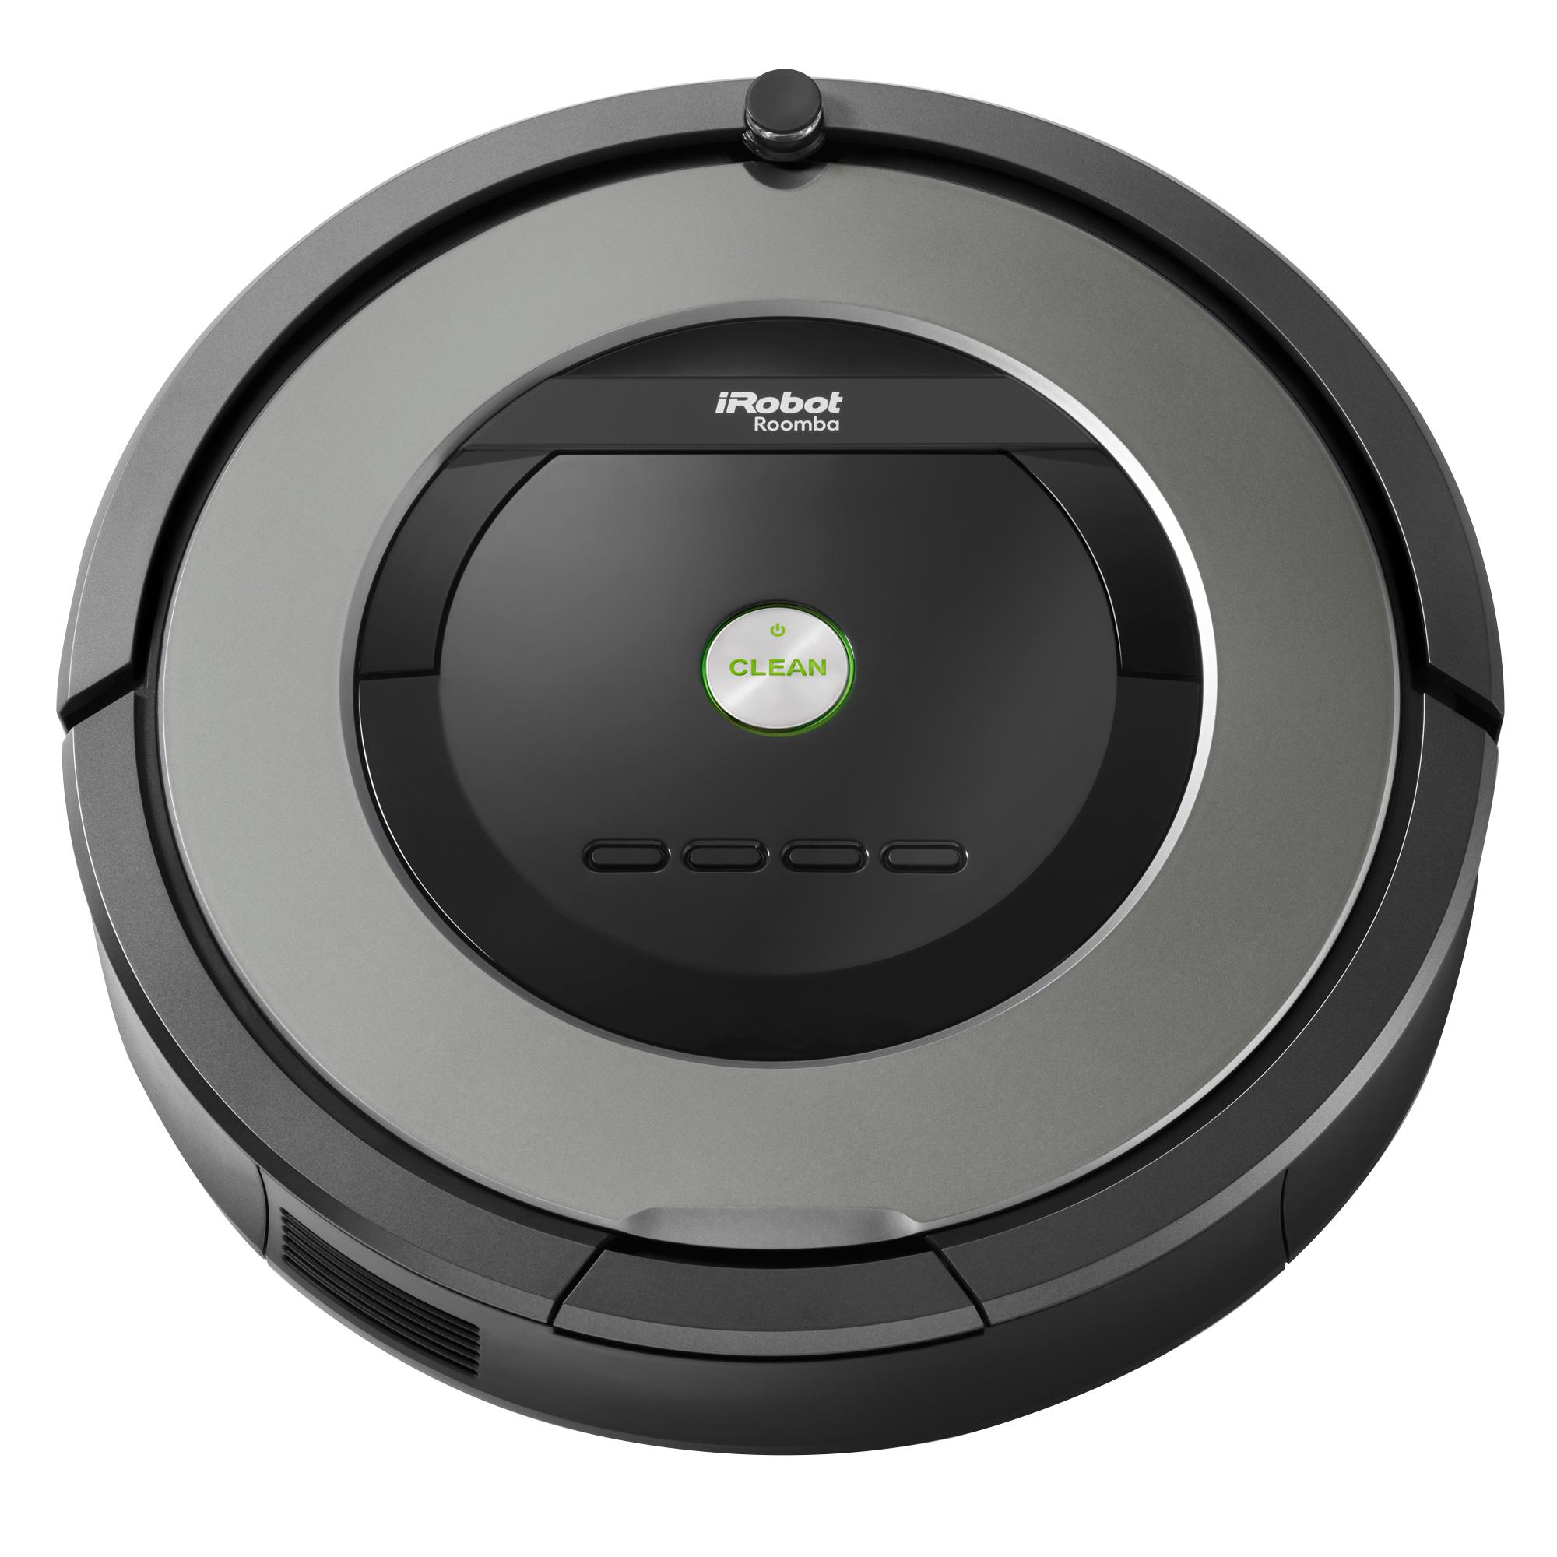
Cyborgs / Androids / Robots
What’s the Difference? Uses for each?

Slide 8
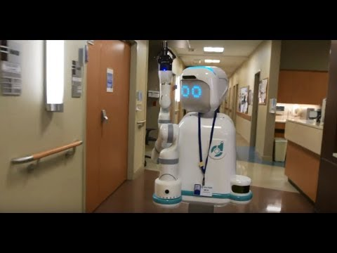
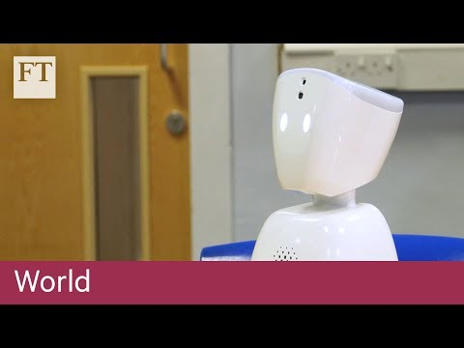
Natural Interaction
Hospitals
Schools

Slide 9
Ethics of Natural Interaction / Future Prospects
Let’s go back to your ethical code. Consider all of the things we have talked about in our presentations and in this course.
Place new scenarios and future AI possibilities on your ethical list.
Do you notice a pattern of where you are placing these things? Does it skew evil? Good? Perhaps this is why it is important that we discuss and learn about this!
“Evil” “Neutral” “Good”

